Slide 1
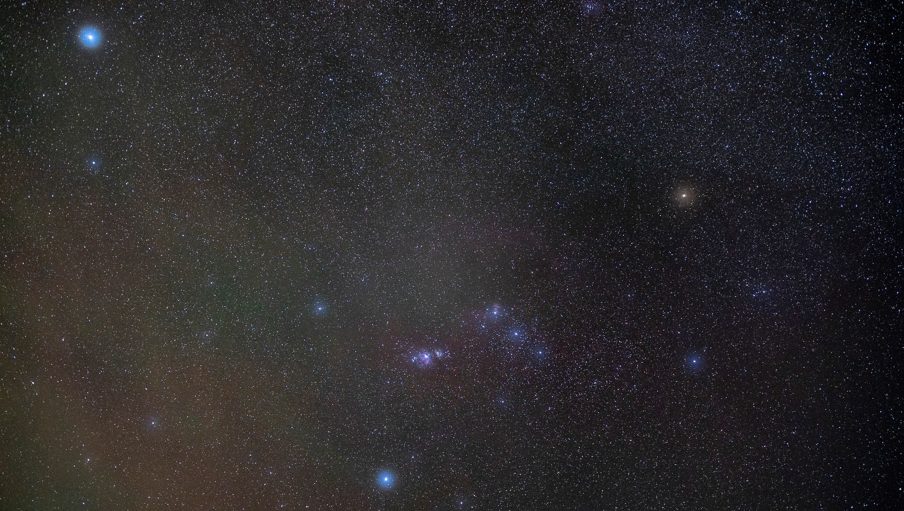
High-Speed Lenses in Astronomy
Prof. Dr.-Ing. Peter C. Slansky
Department II Technology
University for Television and Film Munich
IMC 2024 Kutná Hora

Slide 2
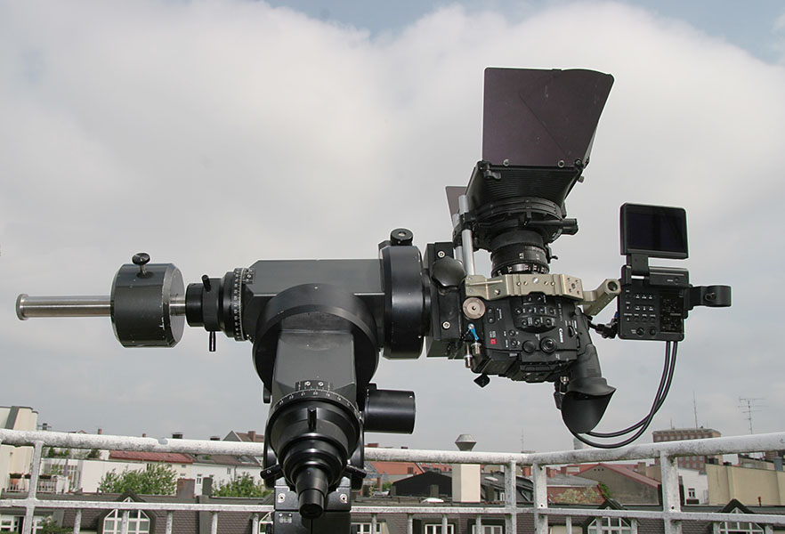
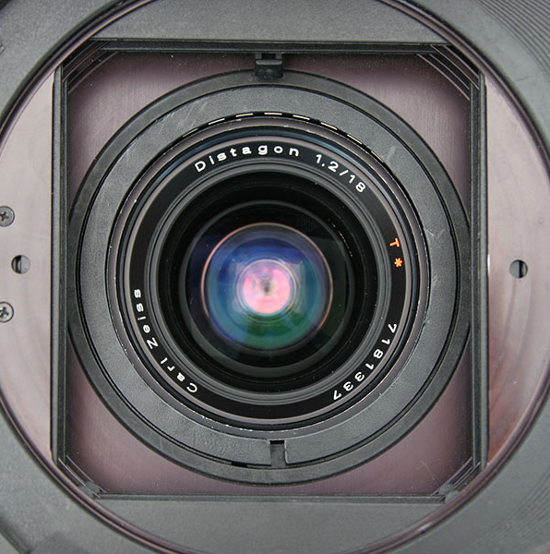
My first Video Meteor Observation: Camelopardalids 2014
Canon C300 with Zeiss Distagon 1.2/18mm (35mm film)
D_{EP} = 15 mm
IMC 2024 Kutná Hora

Slide 3
Why High-Speed Lenses?
IMC 2024 Kutná Hora

Slide 4
Why High-Speed Lenses?
For a shallow depth of field with a “pleasing” bokeh
IMC 2024 Kutná Hora

Slide 5
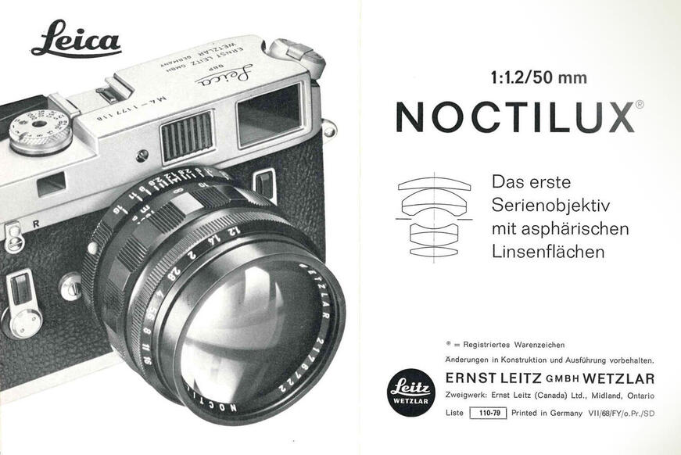
Early High-Speed Lenses for Photography
1961
IMC 2024 Kutná Hora
www.leica-camera.com/de

Slide 6
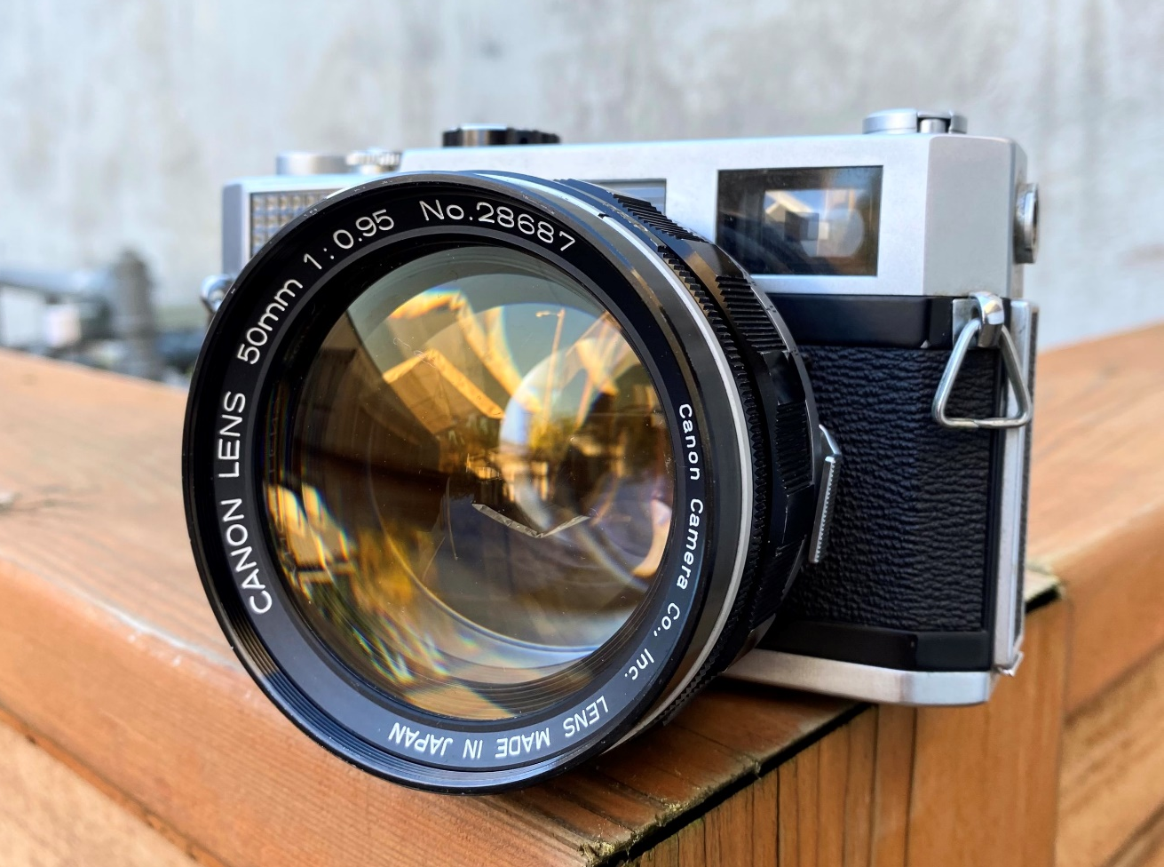
Early High-Speed Lenses for Photography
Canon 7 with
0.95/50mm
7 elements in 5 groups
1961
IMC 2024 Kutná Hora
www.bluemooncameracodex.com

Slide 7
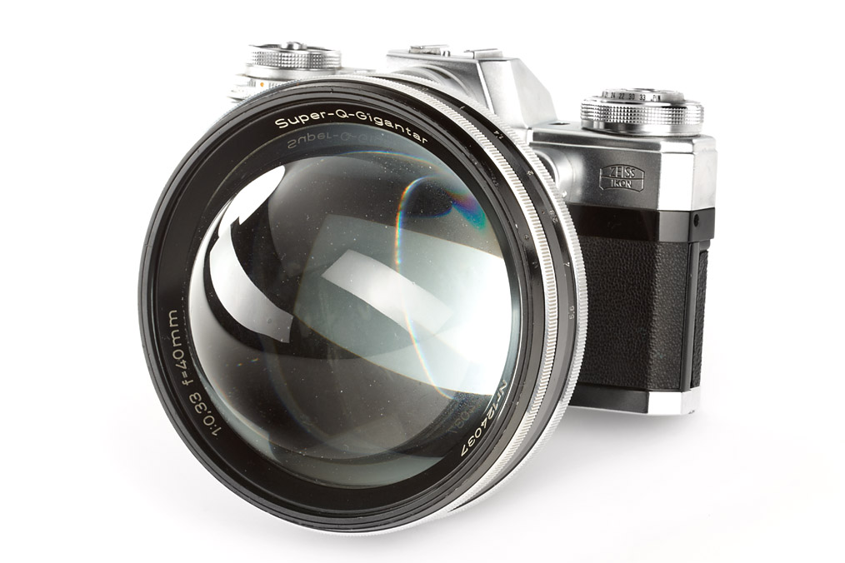
Early High-Speed Lenses for Photography
Zeiss
Super-Q-Gigantar
0.33/40mm
1966
“Q” for “Quatsch”…
IMC 2024 Kutná Hora
www.zeiss.de

Slide 8
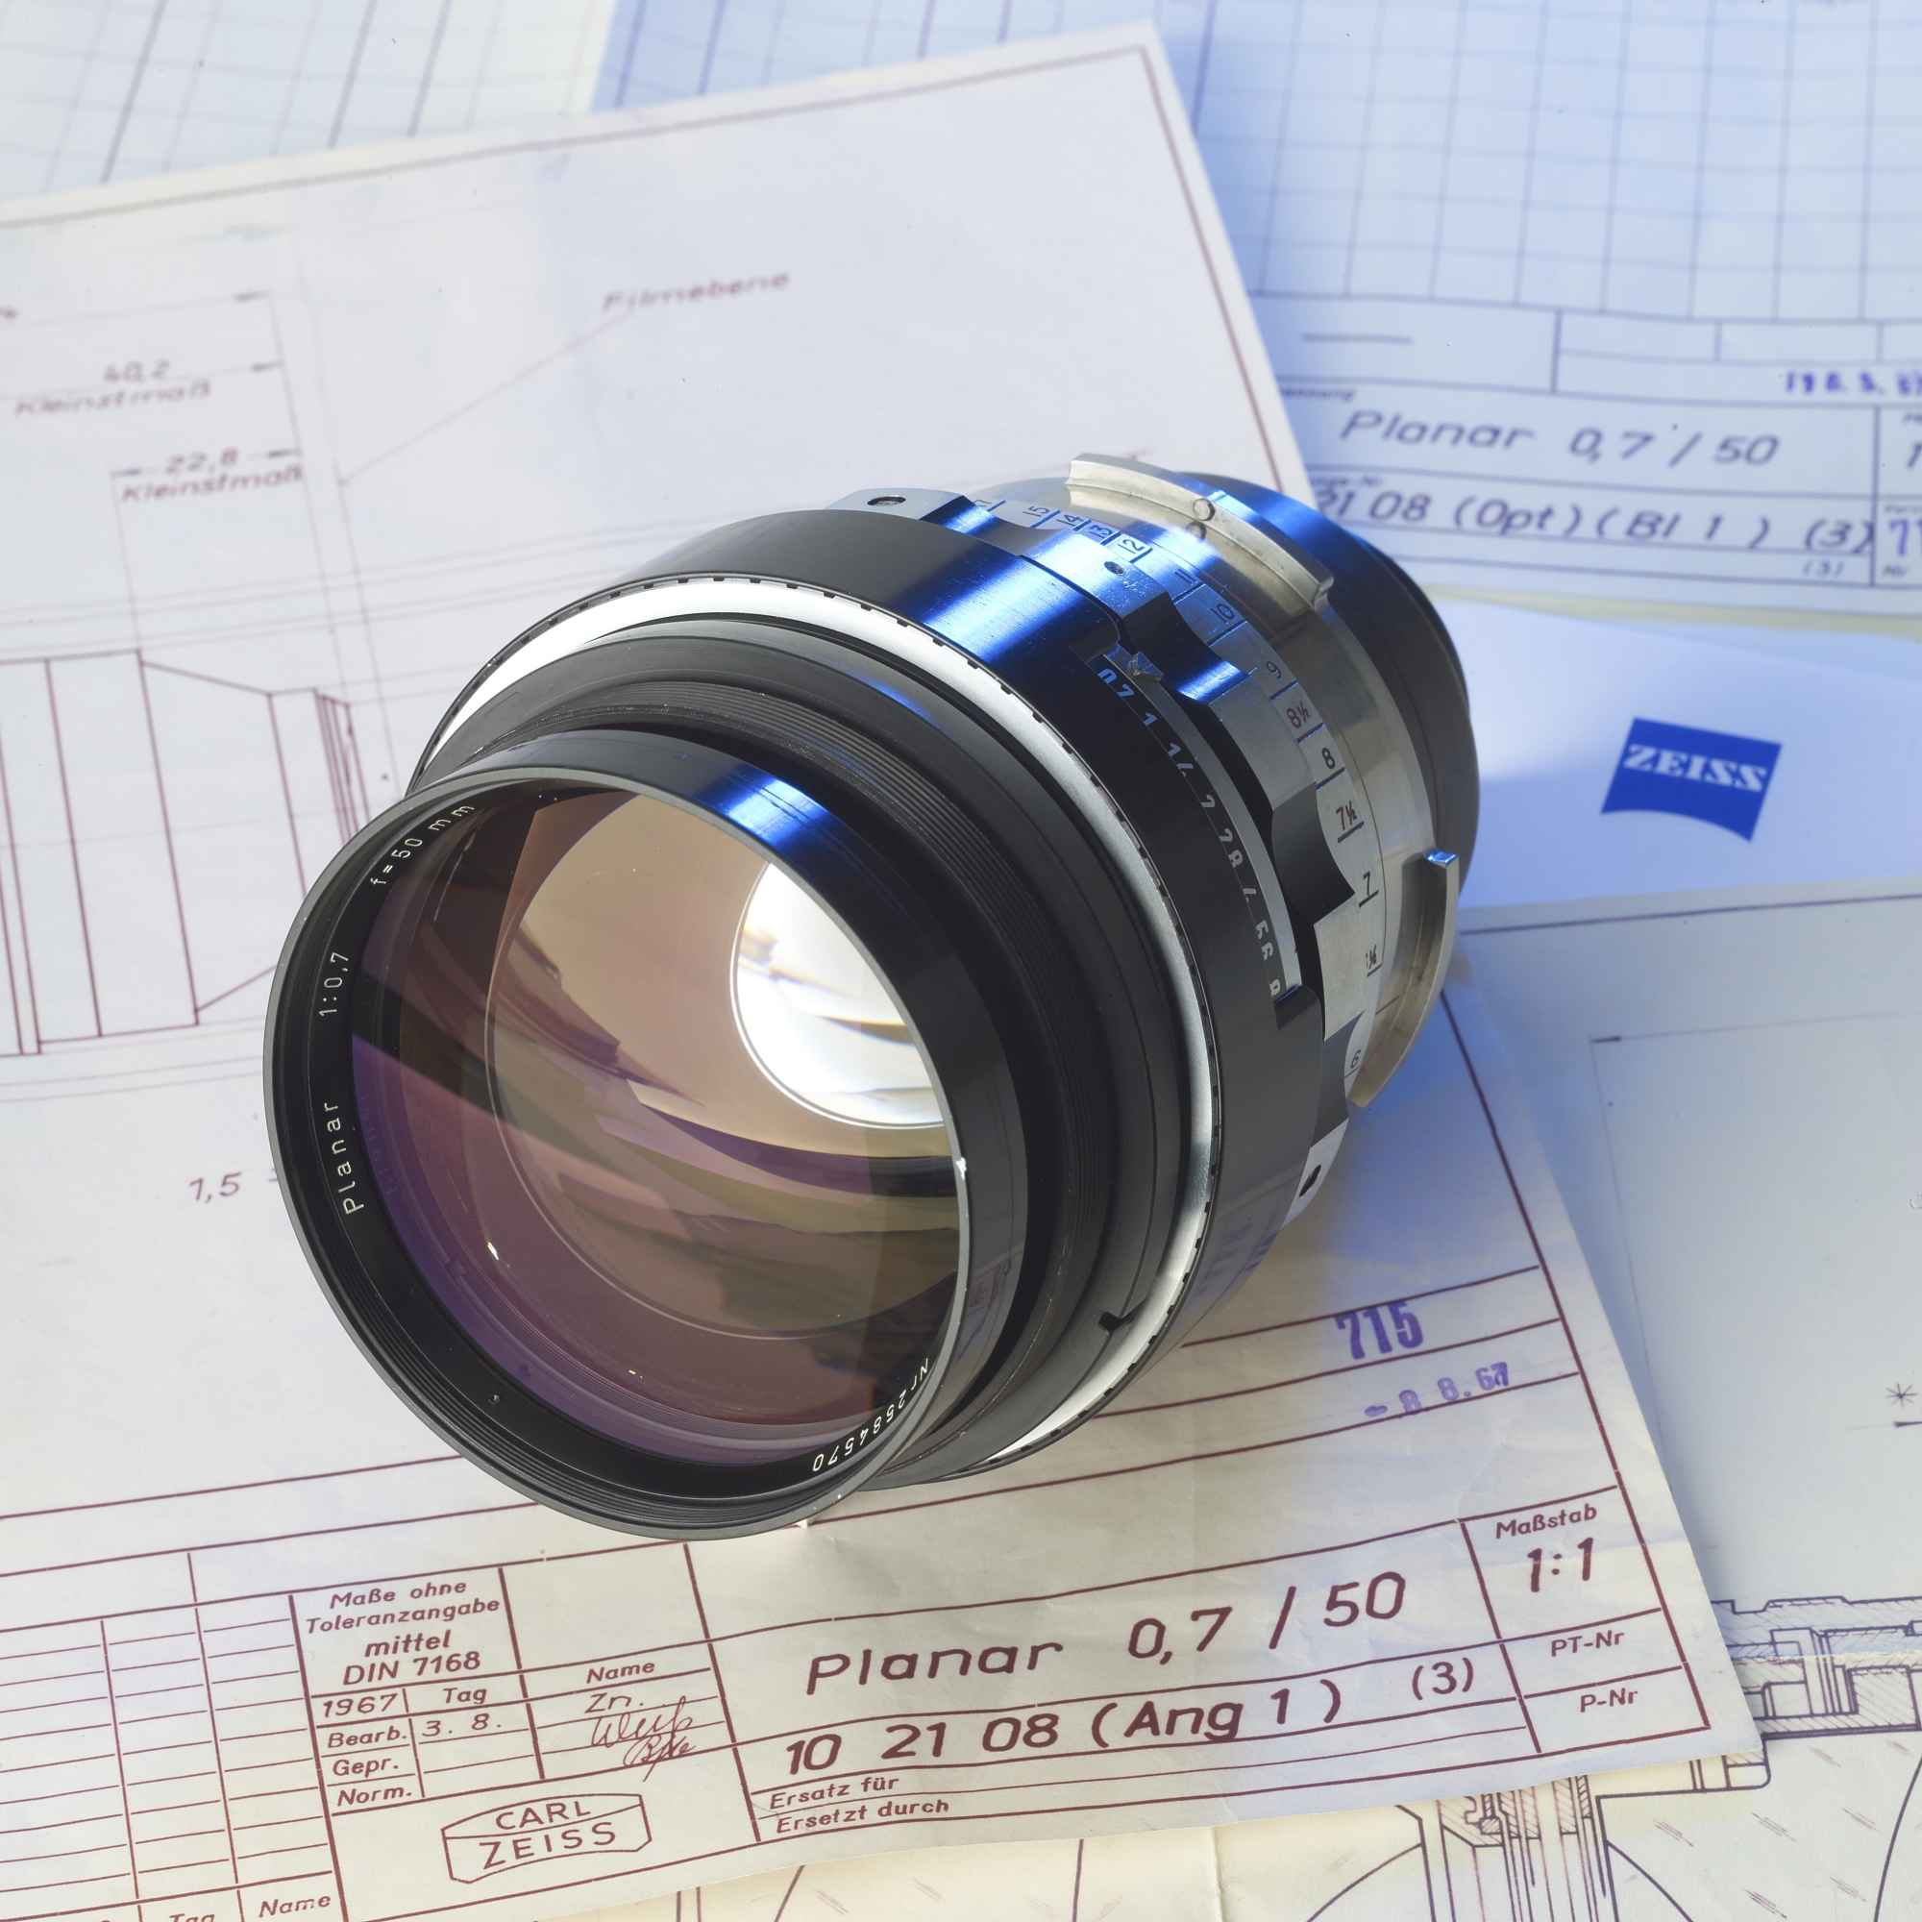
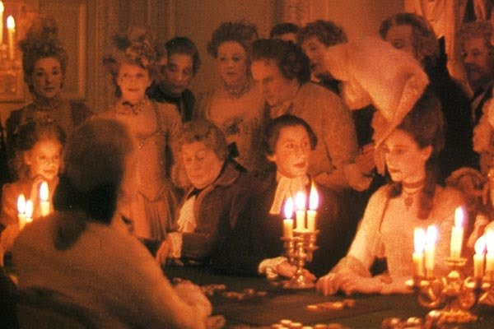
Early High-Speed Lenses in Cinema
Zeiss Planar 0.7/50mm
1967
Barry Lyndon (Director: Stanley Kubrick)
1975
www.zeiss.de
www.rikuwrites.blogspot.com
IMC 2024 Kutná Hora

Slide 9
High-Speed Lenses in Astronomy
In Astronomy we do not have a depth of field
So, we do not see the bokeh
IMC 2024 Kutná Hora

Slide 10
Relevant Optical Parameters
Focal lenght Distance between primary plane of lens and focal point [mm] ⇒ Image (de-)magnification
Image circle Diameter of sharp image [mm] ⇒ Camera sensor diagonal has to fit into this
Field of view Angular dimensions of the image, given by focal length and sensor size [° x °] ⇒ Angular image dimensions
Aperture (Entry Pupil) Size of the free opening of the lens, expressed by its diameter D_{EP} or area A_{EP} ⇒ Light distribution of the lens / Brightness of pointshaped objects
F-stop Quotient between focal lenght and diameter of the aperture F = f / D_{EP} ⇒ Brightness of areal objects
Speed Smallest F-number/largest aperture of the lens ⇒ What it is all about here…
IMC 2024 Kutná Hora

Slide 11
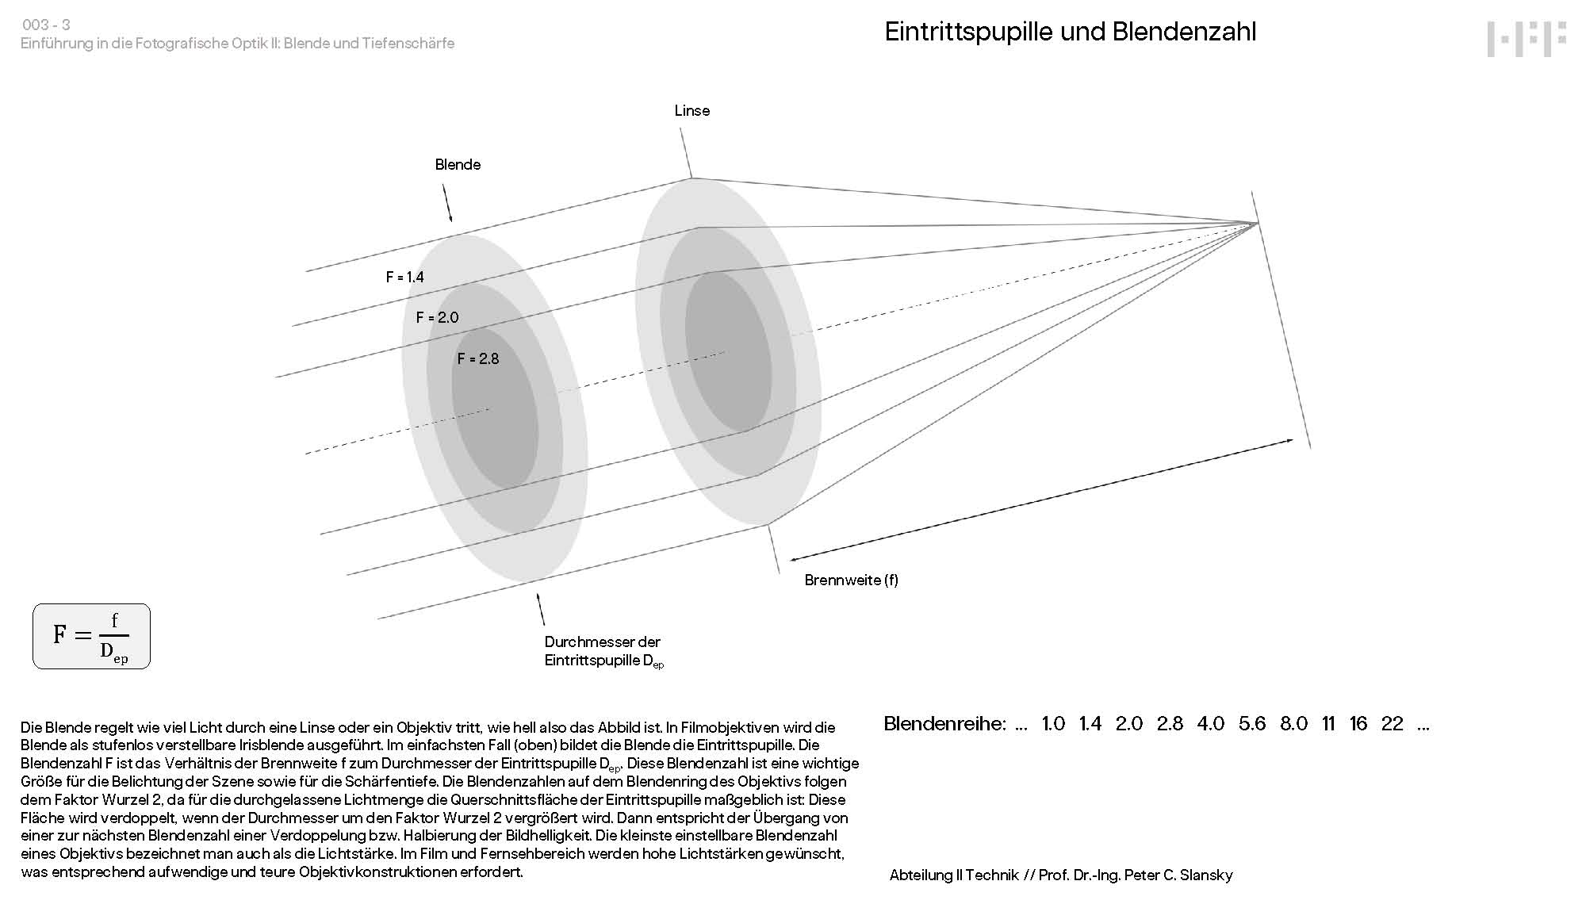

Slide 12
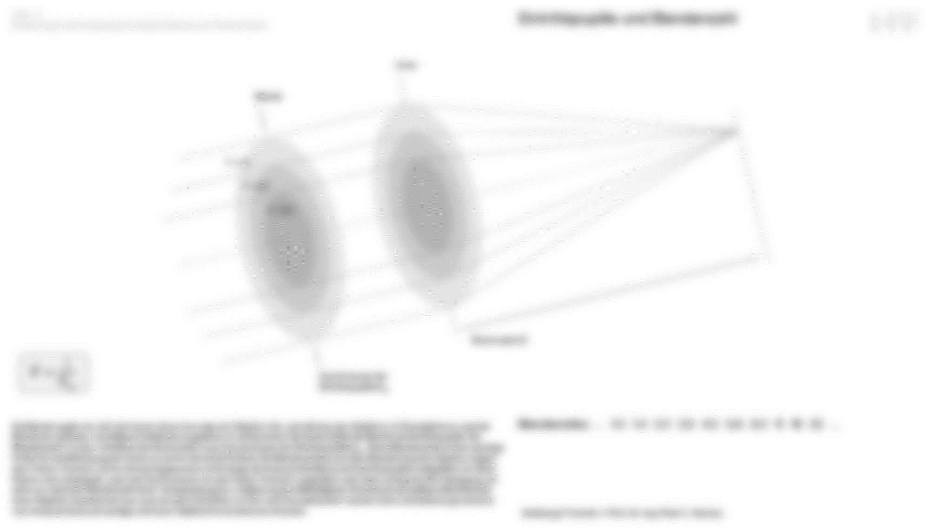
The „Meteors high-speed dilemma“:
For faint meteors we want a large aperture.
This usually comes with a higher focal length.
That means a smaller field of view.
So, we get less meteors…

Slide 13
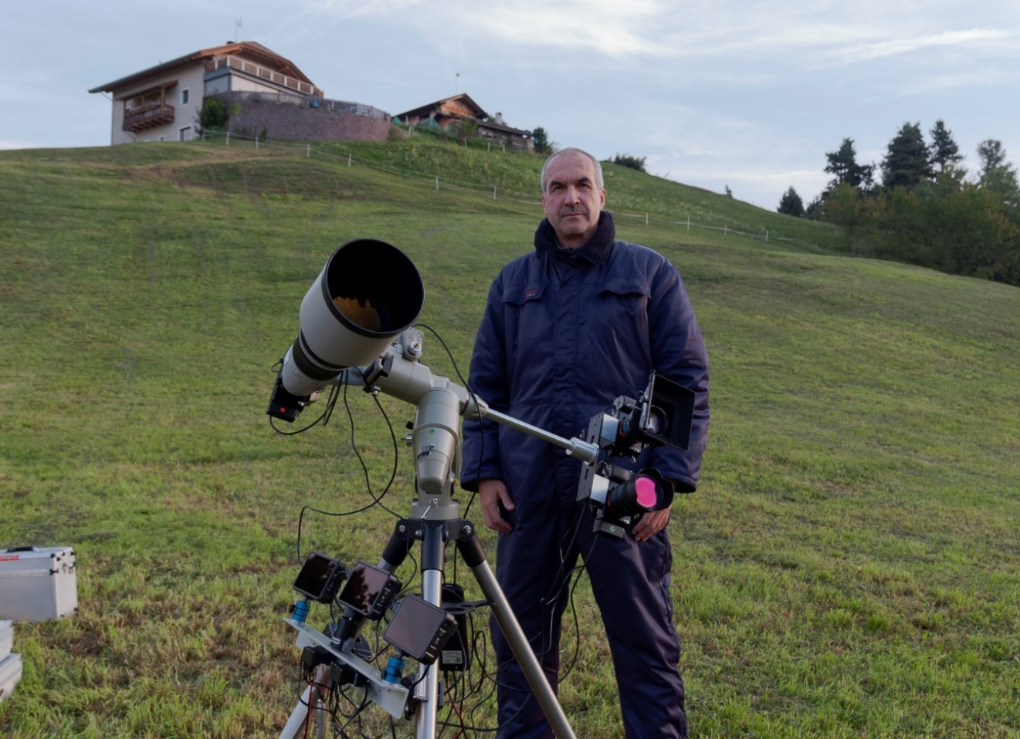
The High-Speed Dilemma: Aperture vs. Field
2.8/400mm
5.1° x 2.9°
D_{EP} = 143 mm
\
1.4/85mm
23.6° x 13.5°
D_{EP} = 60.7 mm
/
21 meteors
in 2 hrs
93 meteors
in 2 hrs
- 1.4/24mm
73° x 45.4°
D_{EP} = 17.1 mm
267 meteors
in 2 hrs
Quadrantids 2020
IMC 2024 Kutná Hora

Slide 14
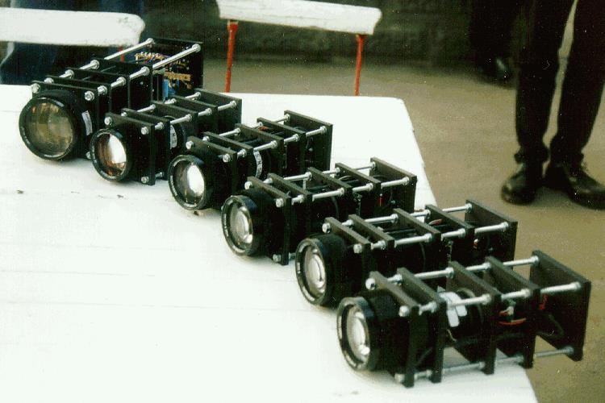
High-Speed Lenses for small Sensor Cameras
De Oude, Delft
Rayxar
0.75/50mm
0.75/65mm
D_{EP 50} = 67 mm
D_{EP 65} = 87 mm
IMC 2024 Kutná Hora
Photo: Sirko Molau

Slide 15
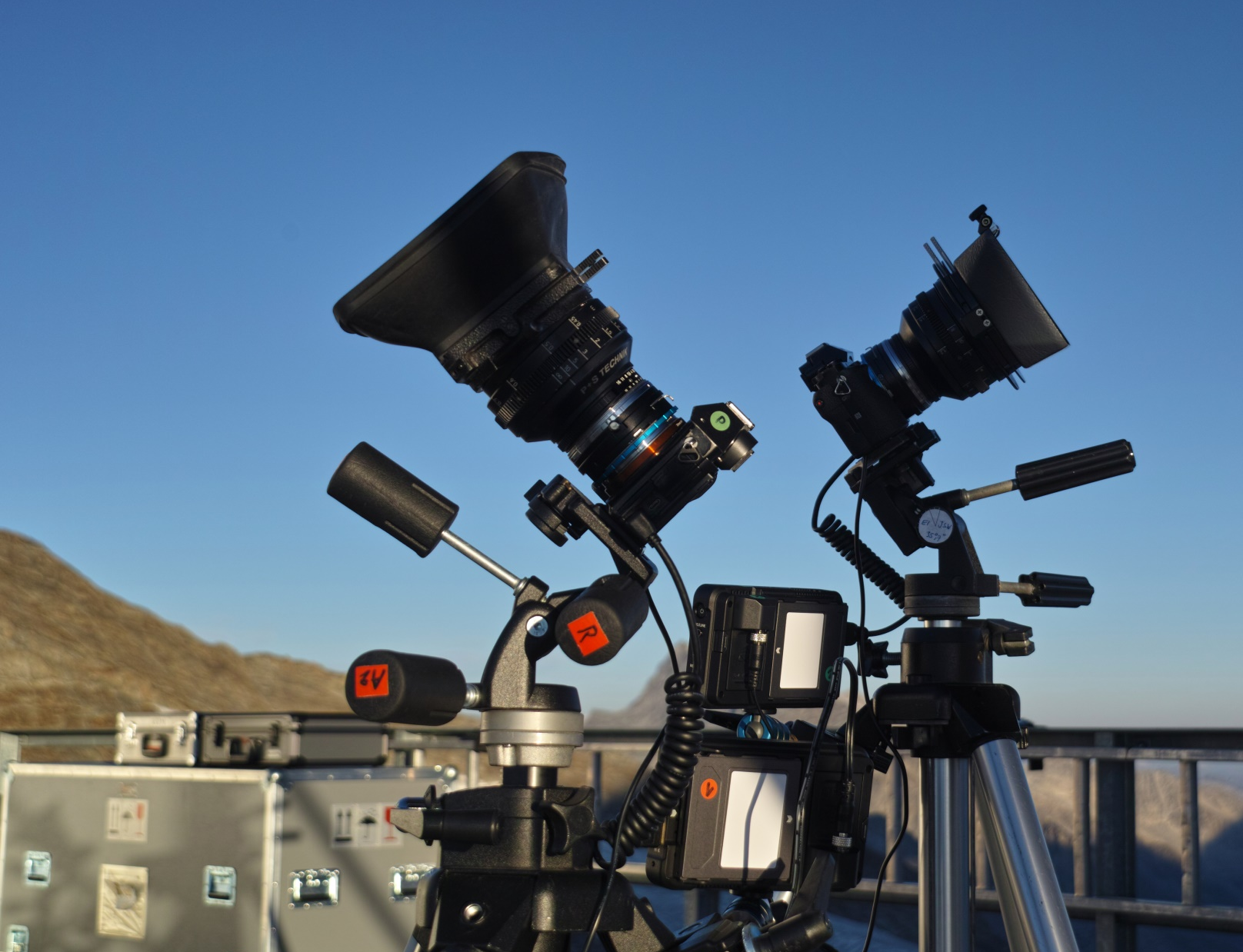
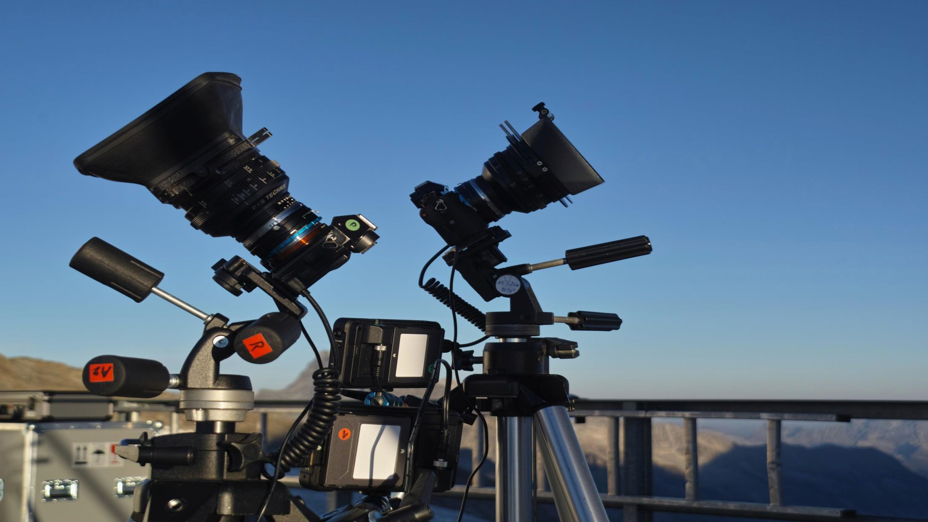
High-Speed Cine Lenses for full Format Cameras
Zeiss Planar
1.4/50mm
1.4/85mm
D_{EP 50} = 35 mm
D_{EP 85} = 60,7 mm
IMC 2024 Kutná Hora

Slide 16
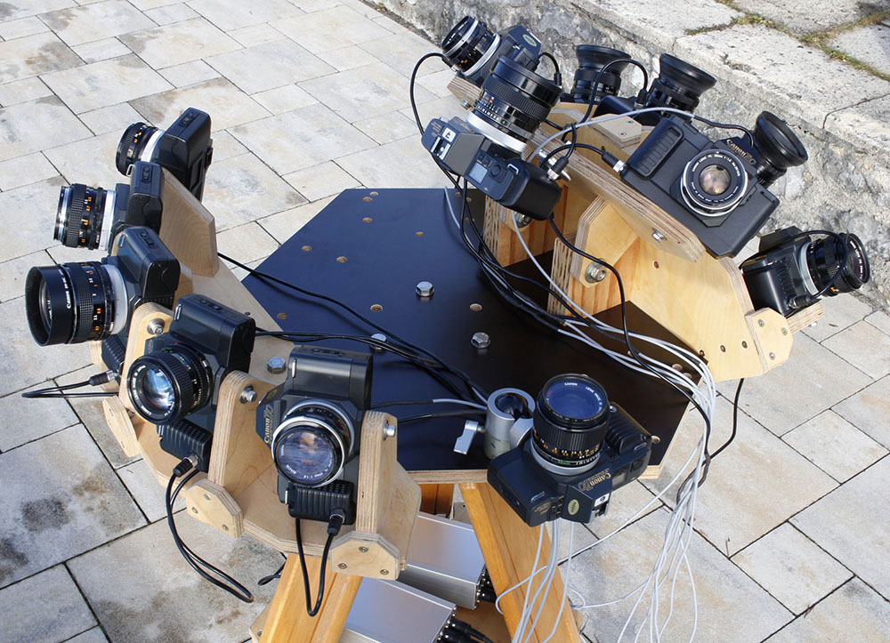
Accumulation of Apertures: Plywood Camera Battery
Up to 13 analog SLRs
Canon T-70 with
Canon FD 1.8/50mm lenses and central timer
40° x 27° field
D_{EP} = 27,8 mm x 13 75 % efficiency:
D_{EP eff} = 87 mm
IMC 2024 Kutná Hora

Slide 17
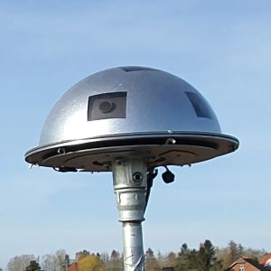
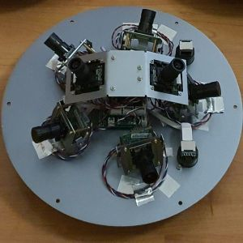
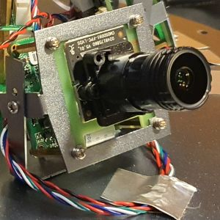
Accumulation of Apertures: All Sky 7
7 cameras with 1.0/4mm lenses; 45° x 80° field
D_{EP} = 4 mm x 7
81,2 % efficiency:
D_{EP eff} = 9.5 mm
IMC 2024 Kutná Hora
www.allsky7.net

Slide 18
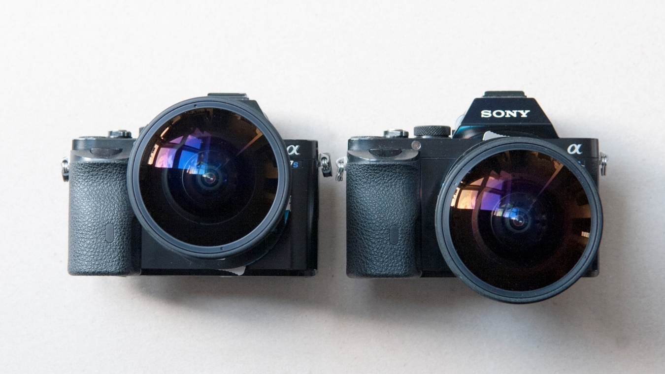
Accumulation of Apertures: All Sky Twin 4K²
2 Sony a7S with
2 Samyang 2.8/14mm
fisheye lenses
on shift adapters
D_{EP} = 5 mm x 2
82 % efficiency:
D_{EP eff} = 6.4 mm
- Low speed
- Uniform brightness
- Uniform distortion
IMC 2024 Kutná Hora

Slide 19
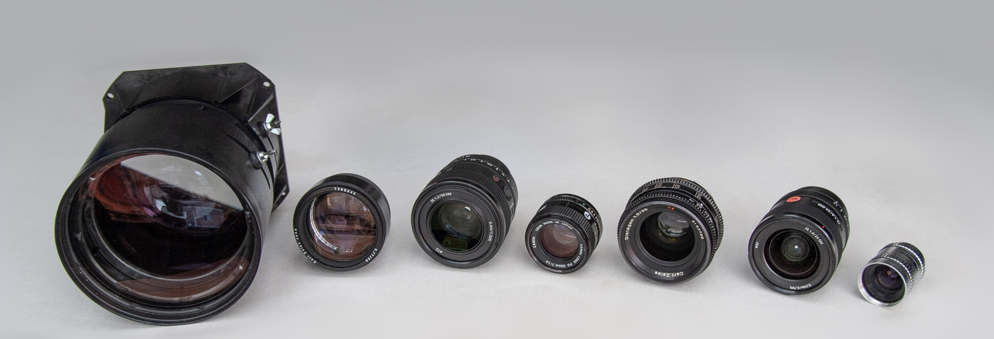
High-Speed Lenses of the Author
Precision HD-8 1.0/140 mm
Projection lens
CRT video beamer
Zeiss 0.77/50mm
Projection lens
16mm
Sony GM 1.2/50mm
Photo lens
Full format
Canon FD
1.4/50mm
Photo lens
Full format
Zeiss 1.2/35mm
Film lens
35mm
Sony GM 1.4/24mm
Photo lens
Full format
Angenieux
1.3/25mm
film lens
16mm
IMC 2024 Kutná Hora

Slide 20
High-Speed Lenses
Is there a physical speed limit?
www.dg77.net/photo/tech/fastex.htm
IMC 2024 Kutná Hora

Slide 21
High-Speed Lenses: What’s the Problem?
Aperture
Contrast
Uniformity of
brightness
Resolution
Freedom of
distortion
Uniformity of
resolution
Image
planarity
Field
IMC 2024 Kutná Hora

Slide 22
High-Speed Lenses: Dream on…
Aperture
Contrast
Uniformity of
brightness
Resolution
Freedom of
distortion
Uniformity of
resolution
Image
planarity
Field
IMC 2024 Kutná Hora

Slide 23
High-Speed Lenses: Reality I
Aperture
Contrast
Uniformity of
brightness
Resolution
Freedom of
distortion
Uniformity of
resolution
Image
planarity
Field
IMC 2024 Kutná Hora

Slide 24
High-Speed Lenses: Reality I
Aperture
Contrast
Uniformity of
brightness
Resolution
Freedom of
distortion
Uniformity of
resolution
Image
planarity
Field
IMC 2024 Kutná Hora

Slide 25
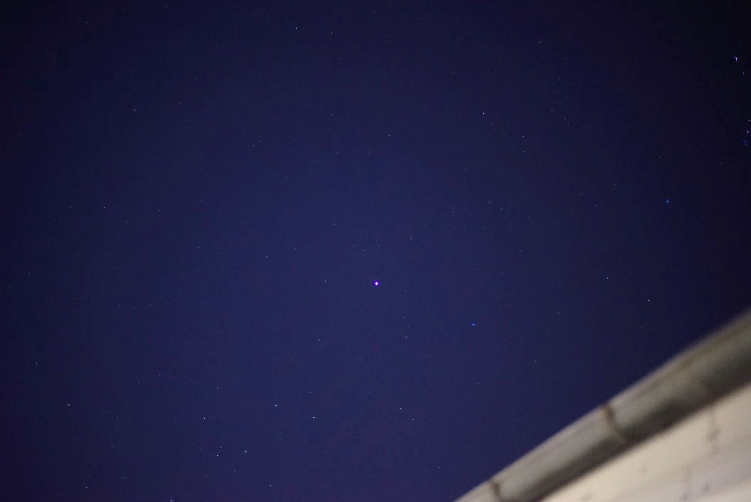
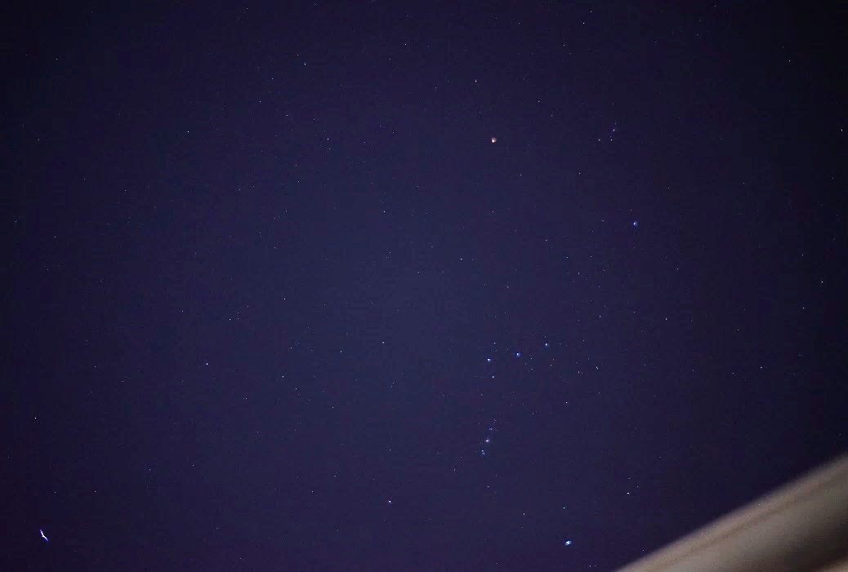
High-Speed Lenses: a practical Quality Test
Sirius in image centre
\
Sirius in image corner
/
IMC 2024 Kutná Hora

Slide 26
High-Speed Lenses: a practical Quality Test
Sirius
Centre
Corner
Canon FD
1.4/50mm
1970
Zeiss Planar 1.4/50mm
1980
Sony GM 1.2/50mm
2020
IMC 2024 Kutná Hora

Slide 27
High-Speed Lenses for Meteor Observation
Conclusions:
Aperture counts – but also field of view
There is no magic stick: if the lens design is subordinated to speed or aperture alone, the other criteria will inevitably suffer (given the budget)
A cheap lens with ultra-high-speed will always have strong artefacts, brightness fall-off and distortion
High image quality from the centre to the corner at F stops 1.2 to 1.4 for full-frame or APS-C comes at a price
Lenses with good correction of all image quality parameters are preferable – even for the price of a F-stop
For astronomic ultra-wide-field imaging such as Meteor observation multi-aperture systems are interesting
Photo with Sony GM 1.2/50mm at F = 1.2 with Sony α7S at ISO 6.400 and t = 4 s
IMC 2024 Kutná Hora

Slide 28
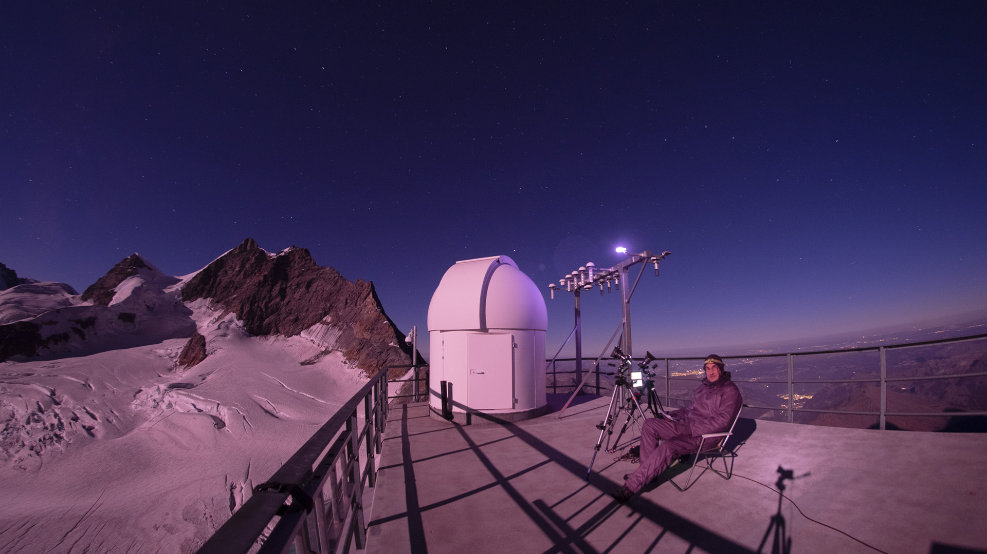
High-Speed Lenses in Astronomy
Prof. Dr.-Ing. Peter C. Slansky
Department II Technology
University for Television and Film Munich
Thank You very much for Your attention !
References:
Slansky, Peter C.: High speed lenses in Astronomy; WGN journal of the IMO 52:1 (2024)
Slansky, Peter C.: Einführung in die fotografische Optik II: Blende und Tiefenschärfe; script at HFF Munich
www.peter-slansky.de
https://leica-camera.com/de-DE/fotografie/objektive/m/noctilux-m-1-12-50mm-asph-schwarz#
https://bluemooncameracodex.com/technical-reviews/living-with-the-canon-50mm-f095-dream-lens
https://rikuwrites.blogspot.com/2010/06/most-beautiful-movie-ever-made.html
www.dg77.net/photo/tech/fastex.htm
https://blog.ormsdirect.co.za/the-worlds-fastest-fake-lens-zeiss-40mm-f0-33/
https://allsky7.net
IMC 2024 Kutná Hora

